Slide 1
Data Visualization
Visualizing your own data or existing dataset
Neighboring Countries and Dissimilar Paths of Growth
John Taden

Slide 2
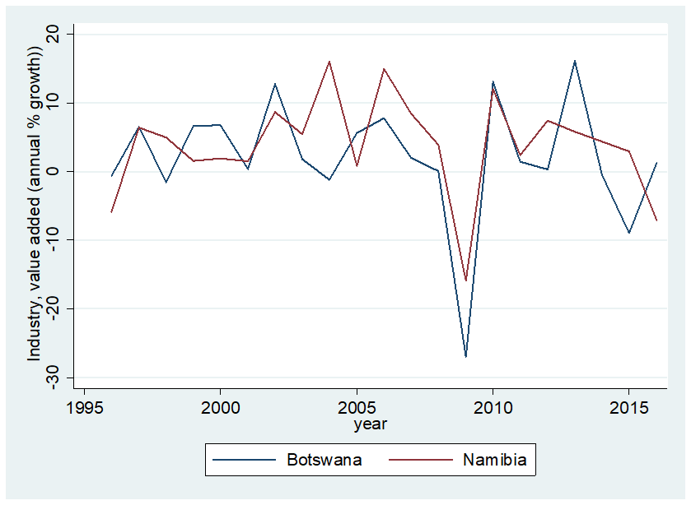
Data Visualization

Slide 3
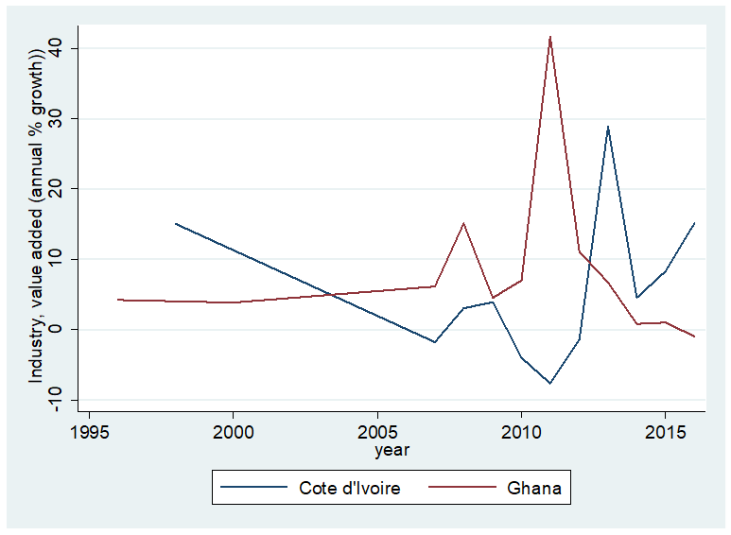
Data Visualization

Slide 4
Data:
WDIs
IMF
Trading Economics
Key Variables:
Dependent:
Industrial growth rate
GDP
GDP PER CAPITA
Independent:
Quality of Government
Trade Interdependence
Technological difference
Cross-border capital mobility

Slide 5
How to answer the question:
1. Visualize the dependent variables against the independent variables
2. Conduct regression analyses and visualize the relationship

